Slide 1
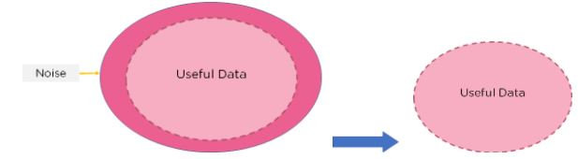

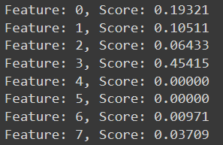
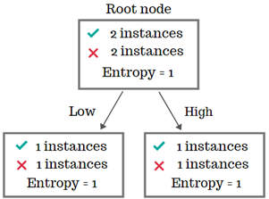
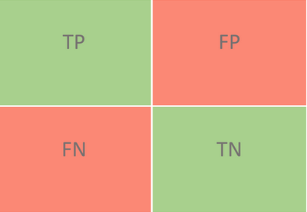
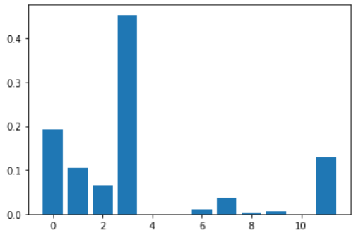
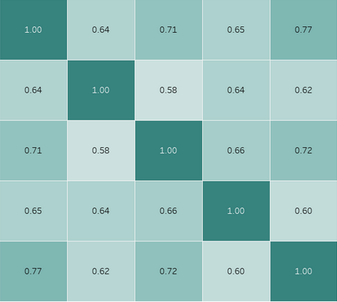

Ways of reducing feature selection with reference to the LEGO Use-Case
Problem: Karpaga Priyaa Velayutham, Patrick Rodriguez Granda Solution: Juan Pablo Vargas Rodríguez, Diego Arnoldo Azuela Rosas Reflection: Nina Sepúlveda Conde, René Francisco Basañez Córdoba
FHWS University of Applied Sciences Würzburg-Schweinfurt | Faculty Business and Engineering | https://fwi.fhws.de TECNOLÓGICO DE MONTERREY | Faculty Industrial and Systems Engineering
PROBLEM
Models with fewer features have:
Better interpretability
Reduced redundancy & noise
Shorter training times
Simpler production code
Less storage space because of reduced dataset
Model accuracy improves
Feature selection is the process of identifying and selecting relevant features for your sample.It is the process of automatically choosing relevant features for your machine learning model based on the type of problem you are trying to solve. We do this by including or excluding important features without changing them. It helps in cutting down the noise in our data and reducing the size of our input data.
RELEVANCE TO LEGO USE-CASE
In the LEGO Use-Case , out of 12 features for the Decision tree modeling , 5 were dropped ie the 'fork_light_barrier', 'acc_sensor', 'width_Lego', 'horizontal_distance', 'length_Lego' and a reduced dataset was created to generate the training and test datasets for higher accuracy modeling of the decision tree model. There are certain techniques involved to filter out the dataset.
Feature importance refers to techniques that assign a score to input features based on how useful they are at predicting a target variable as used in the class solution approach.
SOLUTION
CLASS SOLUTION
ALTERNATE SOLUTIONS
Library → SciKit Library
Assigns a “score” according to the “purity” of feature.
This means how much a specific feature helps us get to a correct prediction.
Information Gain
Confusion Matrix
Entropy used to find the information gain of a variable.
If a variable has a high entropy, it means it's probably more important and therefore should not be eliminated.
Displaying the discrepancies between a true and predicted value and the classes that cause the most noise within the results.
Correlation Matrix
DALEX Library
The correlation value usually goes from 0 to 1 or -1.
We read it as <column> is related to <row> and take the corresponding value as the correlation.
Calculates the level of importance of features using loss functions such as: 'Root Mean Squared Error’ and others to see how it fits.
Advantages
Easy to apply and use, requiring minimum manipulation.
Disadvantages
Errors when dataset has high cardinality.
Permutation Feature Importance
¿What should you choose for your project?
It depends, IT ALWAYS DEPENDS on the project
REFLECTIONS
Developers have come up with these feature selection techniques in order to help make data preparation faster, but it is important to note that we cannot rely on these techniques 100%. While these tools do allow you to work faster, they have their downsides, such as not being able to work on large data sets, or the alignment of the information on certain types of training models. We have to understand that these instruments help us, but aren’t a hands-free solution.
58%
Reduction of selections

